Slide 1
DSC3013 Intro. to Social
Media Analytics (Lec. 11)
Hao PENG
Department of Data Science
City University of Hong Kong
https://haoopeng.github.io/

Slide 2
Agenda for this week
Ethics in SMA
  For normal users, business org.
  For third parties, platform owners
Tutorial on Net. Visualization
Review of final exam

Slide 3
Topics on SMA Ethics
Understand common social media risks.
Comprehend data privacy/anonymization issues.
Be familiar with different kinds of legal issues.
  Defamation / attacks
  Intellectual property
  Spam information
Be aware of potential damages on human well-being.

Slide 4
Social media risks
Risk is the possibility of losing something of value such as, intellectual or physical capital.
Social media risk is the possibility of losing something of value due to social media use.
Credit: Gohar F. Khan

Slide 5
Social media risks
Privacy breaches
Identity theft
Legal risks
Reputation damage
Cyberbullying
Harassment
Phishing scams
Mental health
Addiction

Slide 6
Right of Privacy
“the right to be let alone.” (Warren and Brandeis, 1890)
Privacy in context of social media is the “ability to decide what information one discloses or withholds about oneself on social media, who has access to such information, and for what purposes one’s information may or may not be used.”

Slide 7
Privacy Question
Privacy question
Is social media data private?
Are there caveats / exceptions?

Slide 8
Information on social media
Public Information
Private Information
Deciding which data is private or public depends on the privacy settings of the social media applications in use.
Notes:
When you hide your public posts, they become private

Slide 9
Using social media data
In what circumstances can we use social media data?
Only, if:
The information is publically available, OR
Consent is obtained, OR
The information will be used for research purposes

Slide 10
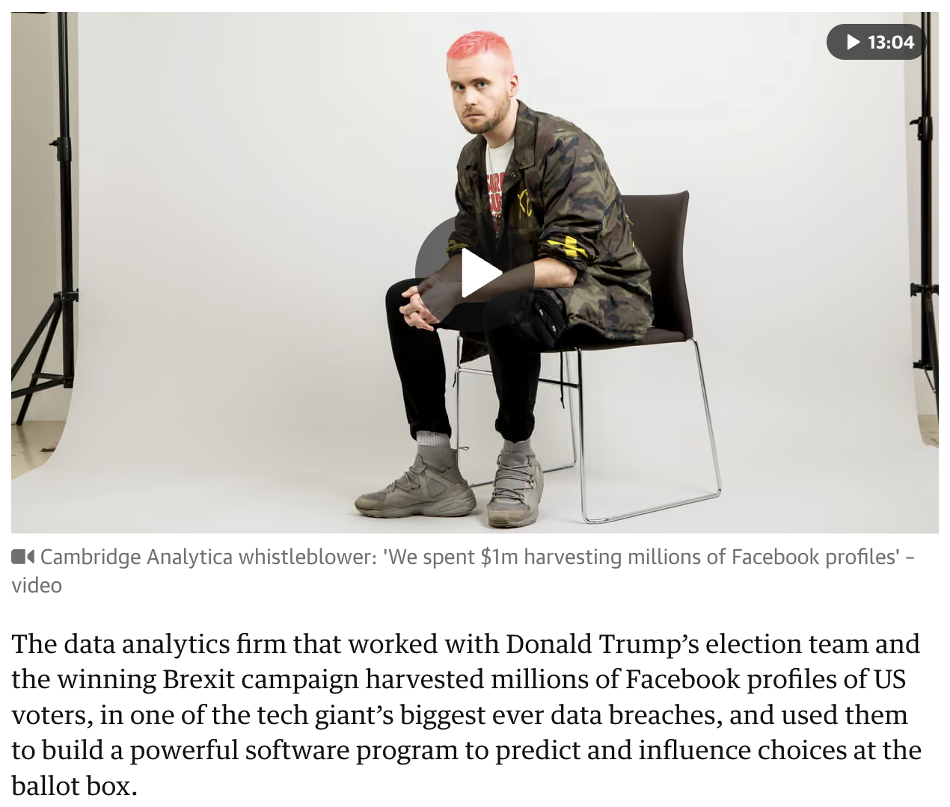
Social media data privacy intrusion
Cambridge Analytica vs. FB
"We exploited Facebook to harvest millions of people's profiles and built models to exploit what we knew about them and target their inner demons. That was the basis the entire company was built on,“Christopher Wylie, 2018.
https://www.theguardian.com/news/2018/mar/17/cambridge-analytica-facebook-influence-us-election
Notes:
By third party
CA is a British political consulting firm which combines data mining, data brokerage, and data analysis with strategic communication for the electoral process

Slide 11

Legal case faced by Snapchat
Case Study: FTC vs. Snapchat
Summary: The Federal Trade Commission (FTC) charged Snapchat in 2014 for deceiving users about the temporary nature of "snaps," claiming they were permanently deleted when they were not.
Outcome: Snapchat settled with the FTC, agreeing to implement a comprehensive privacy program and to be regularly audited.
Don’t be fooled by platforms’ official data policy statement!
Our data is “money” to them.
Notes:
By platform itself
It’s ok for platform to keep our personal data. But it’s not ok when Snapchat specifically declared that our data was destroyed.

Slide 12
Exception to Privacy Protection
Does privacy protection apply everywhere?
Liskula Cohen vs. Google
Summary: Liskula Cohen sued Google and forced Google to reveal the identity of a blogger who defamed her on a blog.
Outcome: Google was compelled to reveal the blogger's identity, setting a case that online anonymity does not protect individuals from defamation claims.
Notes:
anonymity

Slide 13
Social media legal risks
Legal risk is the potential of losing something of value (such as information, reputation, or goodwill) due to the lack of knowledge of the way law and regulation apply to a business or their operations.

Slide 14
Social Media Legal Risks
Social media legal risks
When it comes to legal issues surrounding social media, it essentially answers the question:
What your customers, competitors can sue or be sued for?

Slide 15
What issues can be sued for?
Defamation: Libel and Slander
Trade secrets: Publication of private information
Trademark: confusing customer about trade mark
Copyright: Sharing something that is not yours
Spam: sending unwanted messages/posts
Negligence: assuming a duty, not fulfilling it.
Discrimination: in hiring practices
Sexual harassment: Unwanted social media posting

Slide 16
What is Defamation?
A false statement (written or spoken) about someone which causes damage to that person’s reputation in any form.
Libel: When it is in written form (e.g., comments or post)
Slander: When it is spoken (e.g., audio or video).

Slide 17
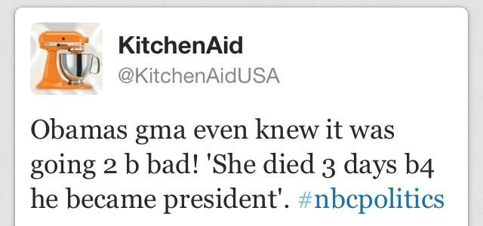
Defamation example
October 3, 2012
Tweet by an employee of KitchenAid using corporate Twitter account.
KitchenAid is an American home appliance brand owned by Whirlpool Corporation.
https://www.agnesday.com/kitchenaid-an-excellent-example-in-social-media-crisis-communications/
Notes:
"gma": Grandmother; often used in texting - OneLook

Slide 18
Defamation discussion Qs
Does defamation law even apply to a tweet?
Who is responsible for the defamatory tweet by KitchenAid?
  The employee and/or the company who owns the account?
Can X be held liable for defamatory comments posted by its users?
Does the responsibility extend to people who retweeted the tweet?

Slide 19
Defamation discussion Qs
Does defamation law even apply to a tweet?
  Yes, “it applies to the Internet the same way it applies to newspapers, magazines, books, films, and other similar publications.” (Luara, 2014).
In most countries,
medium of communication is irrelevant in defamation laws.
  It could be a letter, an email, a social media post, a video, etc.
Notes:
http://melissaagnes.com/are-you-liable-for-tweeting-andor-retweeting-an-offensive-tweet/

Slide 20
Defamation discussion Qs
Can X be held liable for hosting the defamatory comments posted by its users?
NO. Twitter is protected under the Communication Decency Act (CDA), which provides immunity from liability for service providers and users who publish information provided by others (user generated content).
Not having CDA type of laws will cripple social media and free speech!

Slide 21
Defamation discussion Qs
Who is responsible for the defamatory tweet?
Kitchen Aid may also be protected under the CDA act, given that they have clear policies, guidelines, training about using cooperate social media (actual outcome will depend on the nature of the case, etc.).
So, the employee is responsible.

Slide 22
Defamation Example
Defamation discussion Qs
Does the responsibility extend to people who retweeted the tweet from around the world?
It depends.
Based on laws such as New Zealand’s Harmful Digital Communication Act 2015 (HDCA), you may be held liable for spreading information that was already in the public domain (e.g., re-tweeting a defamatory tweet or sharing someone’s info. that was deliberately made available online by a hacker), given that it harms the individual whom the information is about, and it is unfair and unreasonable for you to share that data.

Slide 23
Intellectual Property
IP is the creations of the mind which includes:
  Trade secrets
  Trademarks
  Design
  Copyright
Intellectual property rights are rights granted to IP creators.
  They are often companies in the business world.

Slide 24
Intellectual Property
Who owns the IP rights of materials posted on social media?
Material could be:
  Ideas
  Documents
  Pics
  Songs

Slide 25
Intellectual Property
Who owns the IP rights of materials posted on SM?
  The original owner/author.
  [ask for permission before reusing someone’s content]
  However, most SM posting (Tweets, Comments) may not meet the minimum IP creativity criteria and may not have copyright projection.

Slide 26
Intellectual Property
Trademarks: registered symbol/logo of a business.
You may be liable for creating a brand handler or an account similar to other brands that confuses other social media users.
You may also be liable for the use of other trademarks (artworks) with restricted license (e.g., Creative Commons Non Commercial license)
Notes:
You maybe liable for creating a brand handler/account similar to other brands that confuses other social media users
There may also be liability for use of other trademarks in Google Adwords, Keywords, Metatags usage.

Slide 27
Intellectual Property
Trade secrets
  Not generally known to public, can be a formula, an algorithm, a design, a recipe, a process, a method, a lecture slide, etc.
Can easily be leaked on social media, often mistakenly.
  Anthropic accidentally leaked the source code for Claude Code, due to “human error” in 2026.
  Don’t post our lecture slides online!

Slide 28
Intellectual Property
Trade secrets
An employee leaking trade secrets through social media (or through any other medium) breaches:
  Duty of loyalty
  Breach of contractual confidentially
  Non-discloser agreement
  Misappropriation of trade secrets, etc.
Which can lead to job termination and legal consequences.

Slide 29
Intellectual Property
Trade secrets
How to stop it from happening?
  Updated social media use policies
  (e.g., What employees should not discuss about the company’s secret information on social media.)
  Updated non-disclosure agreement (NDA)
  (A legal document prohibits material, knowledge, or information exchange with third parties.)
  Exit interviews
  Training

Slide 30
Spam intrusion
Spam: sending bulk unwanted messages/posts
A commercial / marketing message sent without consent of the recipient is considered as spam.
Can happen for unsolicited surveys sent on Social Media.

Slide 31
Spam avoidance
To comply:
Obtain consent (written or verbal)
  e.g., send messages only to people who follow you.
Keep your messages header honest
Provide opt-in and opt-out options

Slide 32
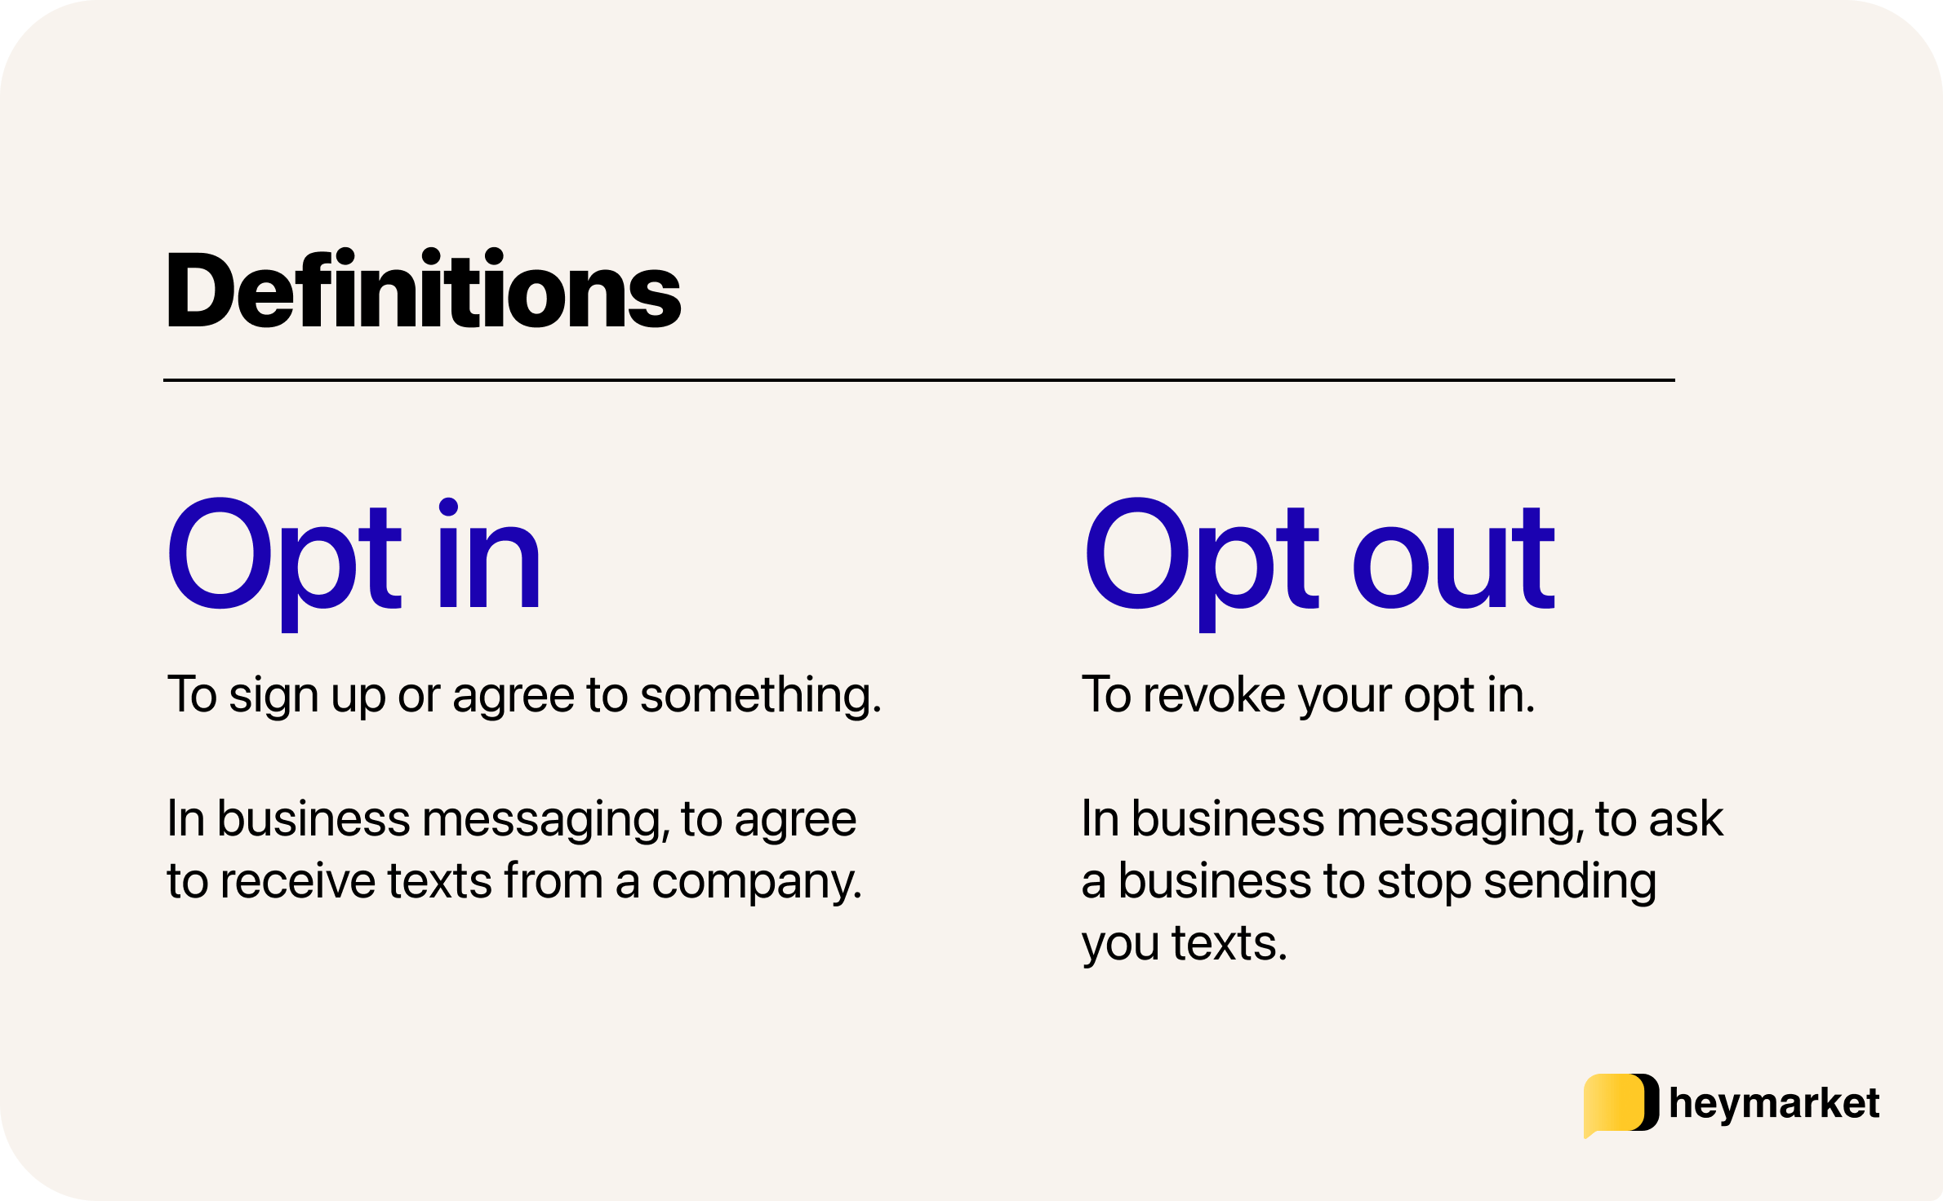
Safe option: Opt-in & Opt-out

Slide 33
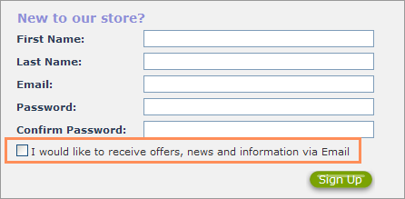
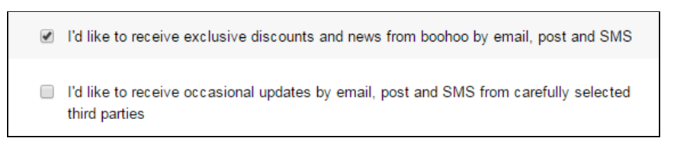
Safe option: Opt-in & Opt-out
Opt-in requires a customer to actively tick a box to receive further messages.
Opt-out requires customers to untick a pre-ticked box to not receive further correspondence.

Slide 34
Social media and well-being
Screen/platform addiction (rewire our dopamine system)
Physical & mental illness (eyesight, stress, peer pressure)
Decreasing human skills
  Offline interaction
  Communication
  Socialization
  Lack of concentration
  Loss of focus / motivation / discipline
(Junk) information overloads our cognitive capacity
Post-course challenge: Deactivate your social media for 3 clean days!

Slide 35
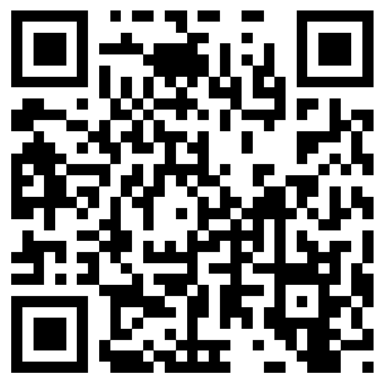
LOQ course evaluation
Appreciate your valuable feedback!
LOQ system: https://onlinesurvey.cityu.edu.hk/
Or on Mobile App:
Notes:
Important nodes identified by PR are quite different from that identified by DC.

Slide 36
Course note
This week
  HW2 due on Nov 13
Next week
  Presentation order follows Group num.
  Submit slides before class time (due date is Nov 16 for all teams regardless of your presentation week)!
  Include all necessary sections (e.g., Lite review, names)
Tutorial 6: Network Visualization
Final exam review & QA
  Cheat Sheet: up to 5 A4 papers (10 pages)
  Optional (digital or handcrafted)

